Slide 1
Lecture 17:
General bank management
Mishkin Ch 9 – part A
page 219-229

Slide 2
Outline
The bank balance sheet
  money
  How do banks get funds and use funds.
T-accounts
  business
  How do banks operate?
Bank management
  risk
  Manage risk to be within proper limits.

Slide 3
The bank balance sheet
Balance sheet of a bank is a listing of its assets, its liabilities and bank capital.
Assets:
  what the bank owns, uses of funds
Liabilities
  what the bank owes to others, sources of funds
Bank capital
  Bank’s net worth, defined to be the difference between its assets and its liabilities

Slide 4
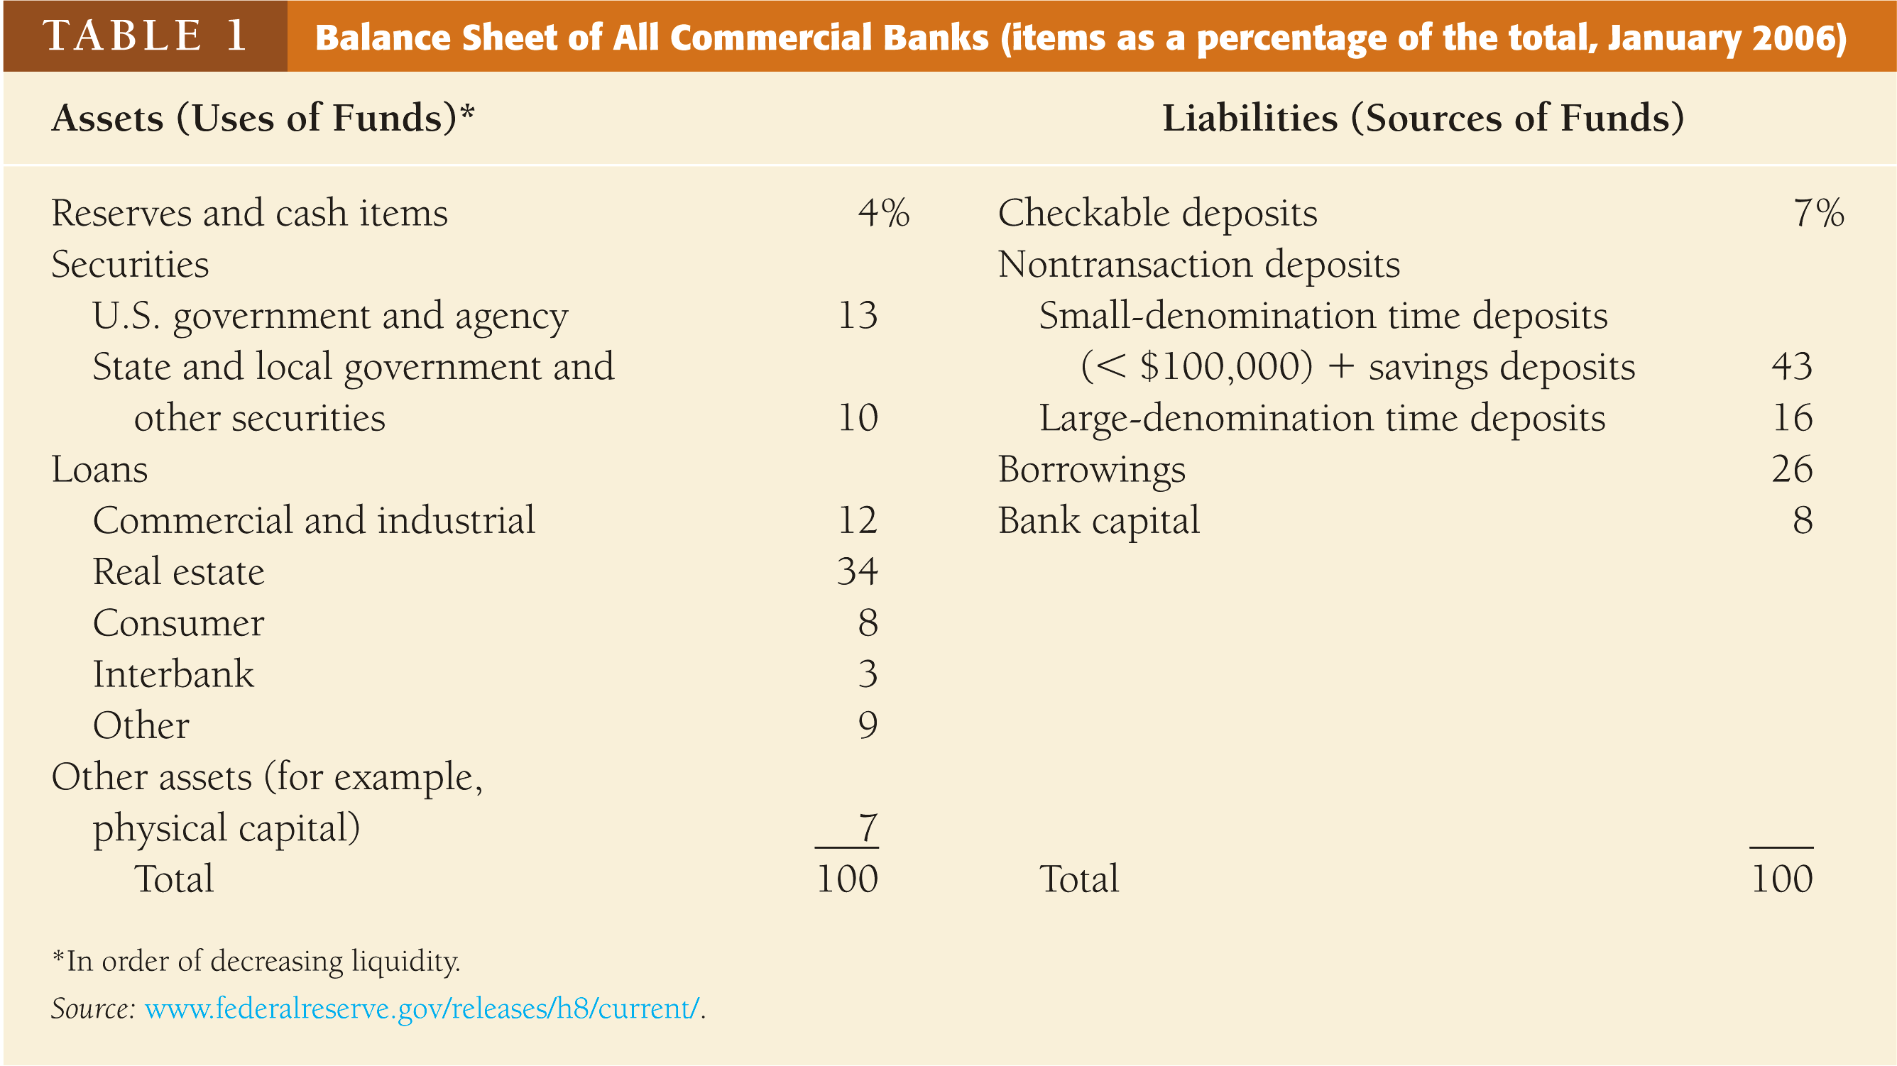
  Assets = Liabilities + Bank Capital

Slide 5
Liabilities
Liabilities are a bank's sources of funds, it specifies what the bank owes to others .
Checkable Deposits:
  checking accounts, etc.
  liquid, payable on demand, decline in importance
Nontransaction Deposits:
  interest-bearing savings accounts and time deposits (e.g. CDs).
  the primary source of bank funds.
Borrowings:
  loans obtained from the Fed (discount loans), other banks (in overnight Fed funds market), corporations, etc.
  an increasingly important source of bank funds.

Slide 6
Bank capital
net worth
raised by selling new equity (stocks) or from retained earnings
a cushion from insolvency

Slide 7
Assets
Bank assets indicate use of bank funds.
Reserves:
  vault cash + deposits in an account at the Fed
  required reserves + excess reserves
Cash in the process of collection
Deposits at other banks
1 - 3 are cash items only 4%

Slide 8
Assets – cont’d
Securities:
  not allowed to hold stocks, they hold debt instruments (bonds)
  short-term U.S. government bonds are "secondary reserves"
Loans:
  relatively illiquid, greater default risk
  primary profit source for banks
Other Assets: physical assets, etc.
4 - 5 are income-earning assets

Slide 9
T - account
Bank performs asset transformations.
‘borrows short and lends long’
Use T-account to keep track of bank’s business.
T-account is a simplified balance sheet, that lists only the changes that occur in balance sheet items starting from some initial balance sheet position.

Slide 10
Example 1 - cash deposit
First National Bank
Assets |  | Liabilities
Vault Cash | +$100 | Checkable deposits | +$100
Opening of a checking account leads to an increase in the bank’s reserves equal to the increase in checkable deposits.
First National Bank
Assets |  | Liabilities
Reserves | +$100 | Checkable deposits | +$100

Slide 11
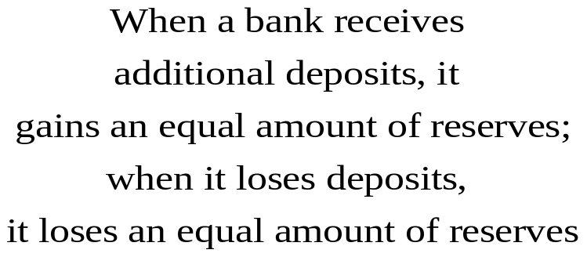
Example 2 - check deposit
First National Bank
Assets |  | Liabilities
Cash items in process of collection | +$100 | Checkable deposits | +$100
First National Bank
Assets |  | Liabilities
Reserves | +$100 | Checkable deposits | +$100
Second National Bank
Assets |  | Liabilities
Reserves | -$100 | Checkable deposits | -$100

Slide 12
Example 3 - making a profit
First National Bank
Assets |  | Liabilities
Required reserves | +$10 | Checkable deposits | +$100
Loans | +$90
Asset transformation: selling liabilities (e.g. checkable deposits) with one set of characteristics and using the proceeds to buy assets (e.g. loans) with a different set of characteristics
The bank borrows short (e.g. checkable deposits) and lends long (e.g. loans)

Slide 13
Bank Management
Liquidity Management
  enough cash and liquidity assets to pay depositors
Asset Management
  diversifying investment
Liability Management
  low cost of getting funds
Capital Adequacy Management
  get enough bank capital as required by regulators
manage credit risk
manage interest-rate risk
manage risks in off-balance-sheet activities

Slide 14
Liquidity management
Banks need to have sufficient reserves or liquid asset to meet obligations to depositors – satisfy their withdrawals.
Too much?
Too little?

Slide 15
Ample excess reserves
Bank
Assets |  | Liabilities
Reserves | $20M | Deposits | $100M
Loans | $80M | Bank Capital | $10M
Securities | $10M
Suppose required reserve ratio is 10%, for $100 deposit, how much required reserve should the bank have?
ample excess reserves
deposit outflow (e.g. $10M)
bank doesn’t need to take actions.
Bank
Assets |  | Liabilities
Reserves | $10M | Deposits | $90M
Loans | $80M | Bank Capital | $10M
Securities | $10M

Slide 16
No excess reserves
Bank |  |  |  |  | Bank
Assets |  | Liabilities |  |  | Assets |  | Liabilities
Reserves | $10M | Deposits | $100M |  | Reserves | $0 | Deposits | $90M
Loans | $90M | Bank Capital | $10M |  | Loans | $90M | Bank Capital | $10M
Securities | $10M |  |  |  | Securities | $10M
Reserves are a legal requirement and the shortfall must be eliminated (bank needs to take actions – it has 4 options – all costly).
Excess reserves are insurance against the costs associated with deposit outflows

Slide 17
Option 1: borrow from the Fed
Bank
Assets |  | Liabilities
Reserves | $9M | Deposits | $90M
Loans | $90M | Borrow from Fed | $9M
Securities | $10M | Bank Capital | $10M
Borrowing from the Fed incurs cost of interest payments based on the discount rate.

Slide 18
Option 2: borrow from other banks
Bank
Assets |  | Liabilities
Reserves | $9M | Deposits | $90M
Loans | $90M | Borrowing | $9M
Securities | $10M | Bank Capital | $10M
If borrow temporarily (overnight), cost incurred is the interest rate (the fed funds market rate) paid on the borrowed funds.
Long-term loans cost much more.

Slide 19
Option 3: sell securities
Bank
Assets |  | Liabilities
Reserves | $9M | Deposits | $90M
Loans | $90M | Bank Capital | $10M
Securities | $1M
The cost of selling securities is the brokerage and other transaction costs, and may incur capital loss.

Slide 20
Option 4: Call in or sell off loans
Bank
Assets |  | Liabilities
Reserves | $9M | Deposits | $90M
Loans | $81M | Bank Capital | $10M
Securities | $10M
Reduction of loans is the most costly way of
acquiring reserves.
Calling in loans antagonizes customers.
Other banks may only agree to purchase loans at a substantial discount.

Slide 21
Liquidity management
Conclusion:
Excess reserves are ‘insurance’ against the costs associated with deposit outflows.
Another ‘insurance’ is holding liquid assets, mainly the ‘secondary reserves’ - short-term U.S. government securities.

